Slide 1
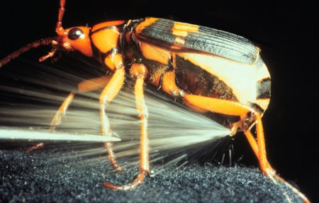
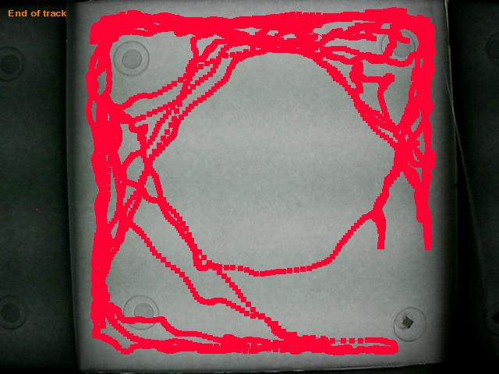
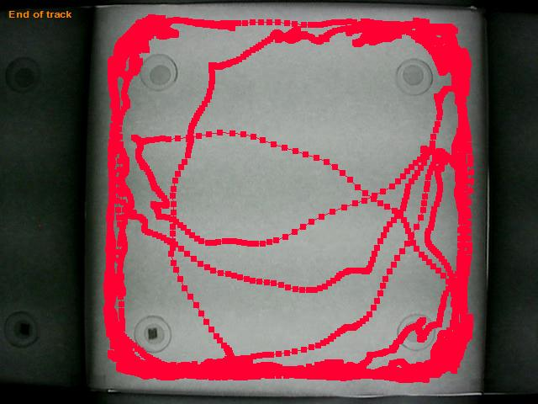
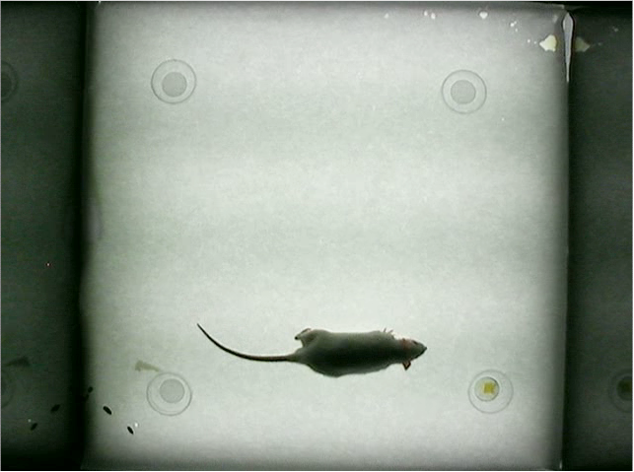
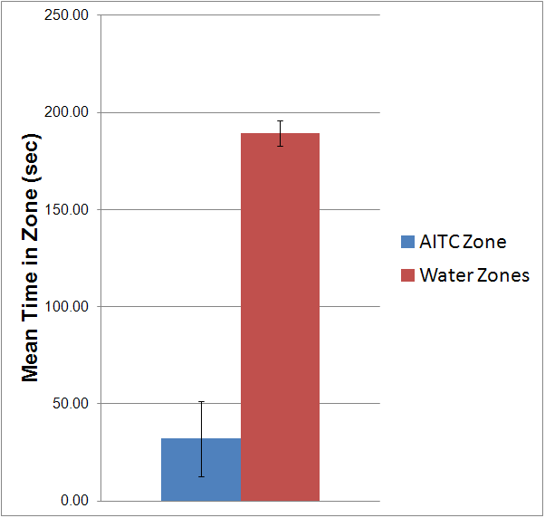
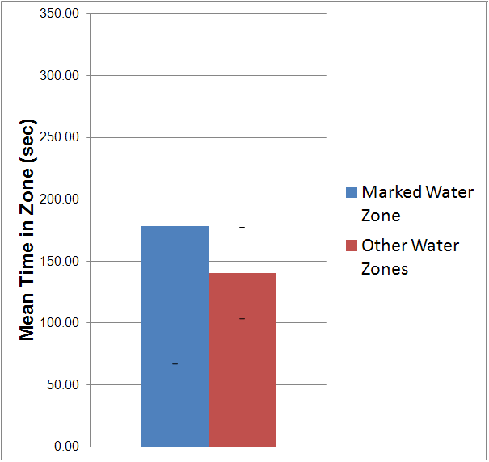
Behavioral Aversion Assay to Assess Predator Responses to Insect Chemical Defense Compounds
Annie Welp, Deirdre Craven, Paige Richards, and Wayne Silver Department of Biology, Wake Forest University, Winston-Salem NC USA
INTRODUCTION
A variety of insect species release irritating chemicals to deter predators. We hypothesize that these defensive chemicals have been selected for over time because they activate mammalian irritant receptors in the trigeminal nerve. The trigeminal nerve innervates the mouth, nose and eyes. It is a main contributor towards mammalian chemesthesis, or the stimulation of the somatosensory system (including pain receptors) by chemicals. For example, stimulating the nose with allyl-isothiocyante (AITC), the active ingredient of wasabi, elicits chemesthesis. Here we demonstrate a behavioral aversion assay that will determine if a model mammalian predator (rat) avoids a presented chemical. In the future, we will use this assay to determine aversion to insect defense compounds.
Figure 1: Sample tracking for a rat in an arena containing AITC in the bottom right corner. Overall, rats spent less time in the irritant quadrant vs. each of the other three quadrants.
Figure 2: Sample tracking for a rat in an arena containing water in every corner. Overall, rats spent an equivalent time in each quadrant.
Figure 5: Example image of rat in arena.
CONCLUSIONS
Using this assay, we were able to demonstrate behavioral aversion of rats to a known trigeminal irritant (AITC). Rats did not avoid any particular quadrant when an irritant was not present. Therefore, this assay is effective in determining whether a particular chemical is aversive to rats. We now plan to test a number of insect defense chemicals at appropriate concentrations to determine whether these compounds elicit behavioral aversion from rats, a representative mammalian predator,. We will also determine which sensory receptors these defense compounds may be activating using physiological and molecular techniques.
MATERIALS and METHODS
The testing arena is constructed by taping a piece of white paper onto the bottom of an opaque-walled Plexiglas box (24 x 24 in) sitting on a light box. A small petri dish containing a piece of filter paper is taped to the underlying paper in each corner of the box (~4 in from any wall). Rats are habituated to the arena by placing them in the set-up box for 10 min on 3 consecutive days. After habituation, rats are placed in the arena with the filter paper in 1 petri dish being soaked in an irritant (the other 3 are soaked in water). The rats’ movements are recorded for 10 minutes. The video is later analyzed (Noldus Ethovision) to track the rat’s movements and determine the time spent in each quadrant of the testing arena. All experiments are done between 11:00am and 1:00pm.
Figure 3: Mean time spent by 8 rats in the irritant quadrant (94% AITC) vs. the mean time spent in each of the three water quadrants. p=5.4e-7 (as determined by a 2-tailed, paired t-test)
Figure 4: Mean time spent by 8 rats in a designated quadrant vs. mean time spent in each of the other quadrants (all sectors contained only water-soaked filter paper). p=0.49 (as determined by a 2-tailed, paired t-test)

